Slide 2
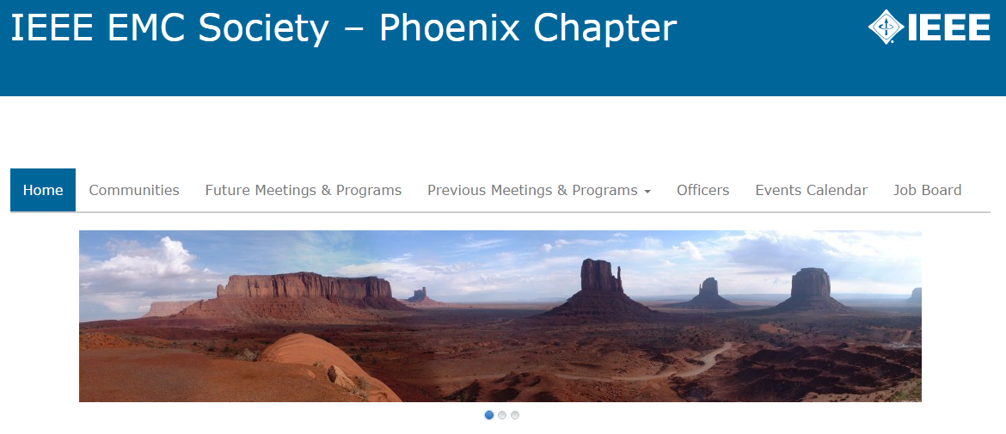

Slide 3
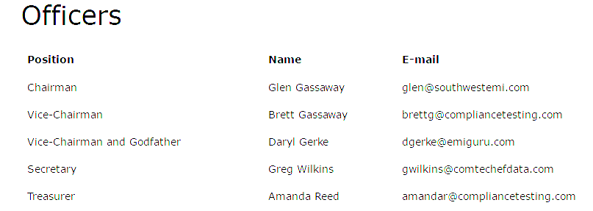
Membership
IEEE Members: 48
..in EMC Society: 35
Mailing List: 234
Average Meeting Attendance: 41
en.wikipedia.org

Slide 4
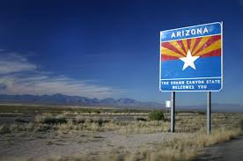
2015-2016 Highlights
Brand-New Website
Regional Events Calendar
Job Board
Involvement with IMS, other local Chapters (eg. WAD)
Great Meeting Location at Compliance Labs!
New Officers.
Much More involvement with Section.
Four Great Meetings.
en.wikipedia.org

Slide 5
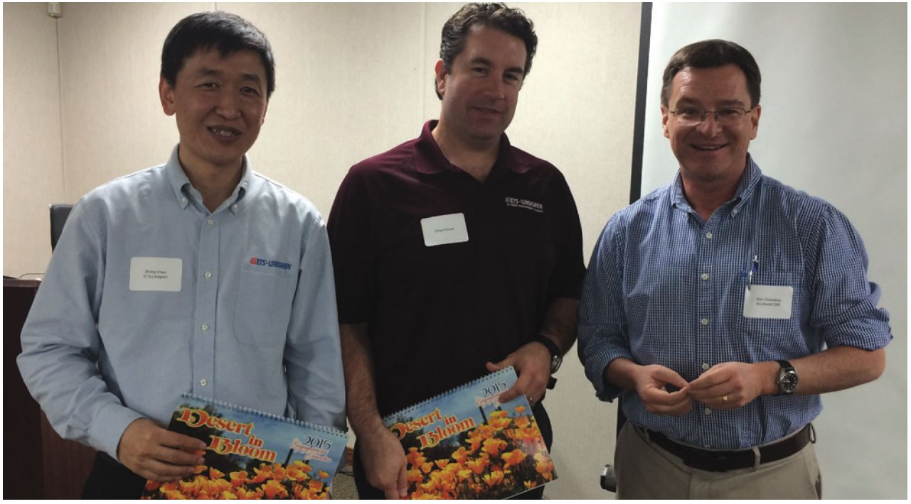
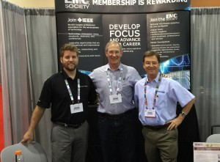
2015-2016 Meetings (to date)
ETS-Lindgren
2015 IMS
Daryl Gerke

Slide 6
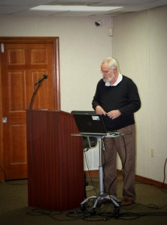
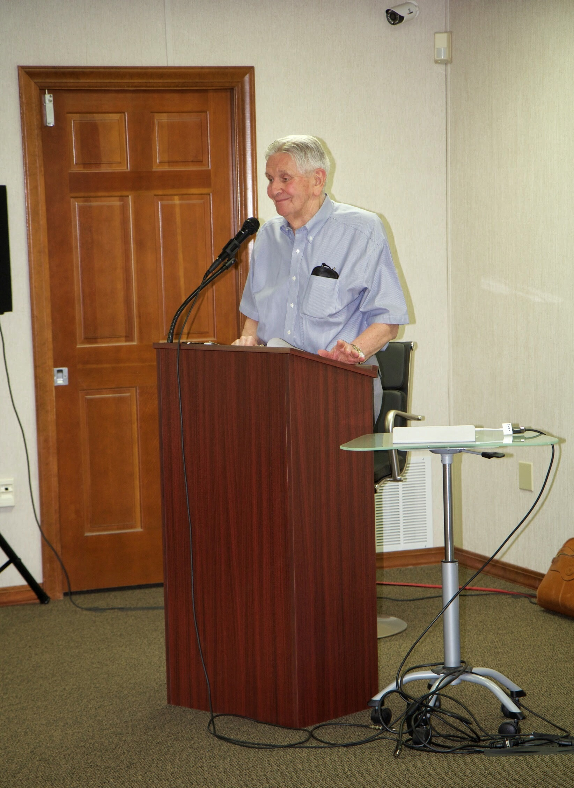
2015-2016 Meetings (to date)
Dr. Bob Scully
Henry Ott

Slide 7
2016-7 Goals
Involvement with local educational institutions (STEM). Membership
August Meeting (Exponent, Dr. Vignesh Rajamani)
Add’l meetings: (Equipment Suppliers, Local Labs and Companies, “Field Trips”)
Trying to break out of the ‘norm’
Mini-Symposium in Spring (TBA)
beautifulplacestovisit.com

Slide 8
2016-7 Goals
Involvement with local educational institutions (STEM). Membership Drive.
August Meeting (Exponent, Dr. Vignesh Rajamani)
Add’l meetings: (Equipment Suppliers, Local Labs and Companies, “Field Trips”)
Trying to break out of the ‘norm’
Mini-Symposium in Spring (TBA)
Thank you Ottawa!!!!

